Slide 1



Lambda and LINQ
Queries on Collections
Lambda
LINQ
LINQ
SoftUni Team
Technical Trainers
Software University
http://softuni.bg

Slide 2

Table of Contents
LINQ
What is LINQ?
Math operations with LINQ
Reading collections in a single line
Data Processing with Lambda and LINQ
Filtering, Mapping, Ordering

Slide 3
Questions?
sli.do #extended-softuni

Slide 4

Lambda Functions and LINQ
f(x) → y
LINQ
LINQ in Action: Filtering, Mapping, Ordering

Slide 5
What is LINQ?
LINQ == Language INtegrated Query
Dramatically simplifies collection processing
List<int> nums = new List<int>() { 2, 4, 3, 1 };
var sum = nums.Sum(); // 10
var min = nums.Min(); // 1
var avg = nums.Average(); // 2.5
var bigNums = nums.Where(a => a > 2).ToList(); // {4, 3}
var reversed = nums.Reverse().ToList(); // { 1, 3, 4, 2 }

Slide 6
Processing Sequences with LINQ
Min() – finds the smallest element in a collection
Max() – finds the largest element in a collection
Sum() – finds the sum of all elements in a collection
Average() – finds the average of all elements in a collection
new List<int>() { 1, 2, 3, 4, -1, -5, 0, 50 }.Min() → -5
new int[] { 1, 2, 3, 40, -1, -5, 0, 5 }.Max() → 40
new long[] {1, 2, 3, 4, -1, -5, 0, 50}.Sum() → 54
new int[] {1, 2, 3, 4, -1, -5, 0, 50}.Average() → 6.75

Slide 7
Problem: Sum, Min, Max, Average
Write a program to read n integers and print their sum, min, max and average values:
5
12
20
-5
37
8
Sum = 72
Min = -5
Max = 37
Average = 14.4
4
50
20
25
40
Sum = 135
Min = 20
Max = 50
Average = 33.75
Check your solution here: https://judge.softuni.bg/Contests/Practice/Index/434#0

Slide 8
Solution: Sum, Min, Max, Average
Use System.Linq to enable LINQ functions like .Max() and .Sum()
using System.Linq;
…
int n = int.Parse(Console.ReadLine());
int[] nums = new int[n];
for (int i = 0; i < n; i++)
nums[i] = int.Parse(Console.ReadLine());
Console.WriteLine("Sum = {0}", nums.Sum());
Console.WriteLine("Min = {0}", nums.Min());
// TODO: print also max and average values
Check your solution here: https://judge.softuni.bg/Contests/Practice/Index/434#0

Slide 9
Reading Collections on a Single Line
Using Select() to read collections:
var nums = Console.ReadLine()
.Split()
.Select(number => double.Parse(number));
// .Select(double.Parse);
var nums = Console.ReadLine()
.Split()
.Select(int.Parse);
// .Select(number => int.Parse(number));

Slide 10
Converting Collections
Using ToArray(), ToList() to convert collections:
int[] nums = Console.ReadLine()
.Split()
.Select(number => int.Parse(number))
.ToArray();
List<double> nums = Console.ReadLine()
.Split()
.Select(double.Parse)
.ToList();

Slide 11
Sorting Collections
Using OrderBy() to sort collections:
Using OrderByDescending() to sort collections:
List<int> nums = { 1, 5, 2, 4, 3 };
nums = nums
.OrderBy(num => num)
.ToList()
List<int> nums = { 1, 5, 2, 4, 3 };
nums = nums
.OrderByDescending(num => num)
.ToList()

Slide 12
Sorting Collections by Multiple Criteria
Using ThenBy() to sort collections by multiple criteria:
Dictionary<int, string> products =
new Dictionary<int, string>();
Dictionary<int, string> sortedDict = products
.OrderBy(pair => pair.Value)
.ThenBy(pair => pair.Key)
.ToDictionary(pair => pair.Key, pair => pair.Value);

Slide 13
Take / Skip Elements from Collection
Using Take(), Skip():
var nums = new List<int>() { 10, 20, 30, 40, 50, 60}
.Take(3)
.ToArray();
// nums = [10, 20, 30]
var nums = new List<int>() { 10, 20, 30, 40, 50, 60}
.Skip(3).Take(2)
.ToArray();
// nums = [40, 30]

Slide 14
Problem: Largest 3 Numbers
Read a list of real numbers and print largest 3 of them
10 30 15 20 50 5
50 30 20
20 30
30 20
0 -5 -1 -3 -2
0 -1 -2
Check your solution here: https://judge.softuni.bg/Contests/Practice/Index/434#1

Slide 15
Solution: Largest 3 Numbers
List<int> nums = Console.ReadLine().Split()
.Select(int.Parse)
.ToList();
var sortedNums = nums.OrderByDescending(x => x);
var largest3Nums = sortedNums.Take(3);
Console.WriteLine(string.Join(" ", largest3Nums));
Check your solution here: https://judge.softuni.bg/Contests/Practice/Index/434#1

Slide 16
Lambda Expressions
A lambda expression is an anonymous function containing expressions and statements
Lambda expressions
Use the lambda operator =>
Read as "goes to"
The left side specifies the input parameters
The right side holds the expression or statement
var lambda = (a => a > 5);

Slide 17
Lambda Functions
Lambda functions are inline methods (functions) that take input parameters and return values:
x => x / 2
static int Func(int x) { return x / 2; }
x => x != 0
static bool Func(int x) { return x != 0; }
() => 42
static int Func() { return 42; }
(x, y) => x+y
static int Func(int x, int y)
{ return x+y; }

Slide 18
Filter Collections
Using Where(), Count():
int[] nums = { 1, 2, 3, 4, 5, 6};
nums = nums
.Where(num => num % 2 == 0)
.ToArray();
// nums = [2, 4, 6]
int[] nums = { 1, 2, 3, 4, 5, 6};
int count = nums.Count(num => num % 2 == 0);
// count = 3

Slide 19
Filtering and Sorting with Lambda Functions
int[] nums = { 11, 99, 33, 55, 77, 44, 66, 22, 88 };
nums.OrderBy(x => x).Take(3);
// 11 22 33
nums.Where(x => x < 50);
// 11 33 44 22
nums.Count(x => x % 2 == 1);
// 5
nums.Select(x => x * 2).Take(5);
// 22 198 66 110 154

Slide 20
Getting Unique Elements from Collection
We can use Distinct() to get the unique elements from a collection:
int[] nums =
{ 1, 2, 2, 3, 4, 5, 6, -2, 2, 0, 15, 3, 1, 0, 6 };
nums = nums
.Distinct()
.ToArray();
// nums = [1, 2, 3, 4, 5, 6, -2, 0, 15]

Slide 21
Problem: Short Words Sorted
Read a text, extract its words, find all short words (less than 5 characters) and print them alphabetically, in lower case
Use the following separators: . , : ; ( ) [ ] " ' / \ ! ? (space)
Use case-insensitive matching; remove duplicated words
In SoftUni you can study Java, C#, PHP and JavaScript. JAVA and c# developers graduate in 2-3 years. Go in!
2-3, and, c#, can, go, in, java, php, you
Check your solution here: https://judge.softuni.bg/Contests/Practice/Index/434#2

Slide 22
Solution: Short Words Sorted
char[] separators = new char[]
{'.',',',':',';','(',')','[',']','\\','\"','\'','/','!','?',' '};
string sentence = Console.ReadLine().ToLower();
string[] words = sentence.Split(separators);
var result = words
.Where(w => w != "")
// TODO: filter by word length < 5
.OrderBy(w => w).Distinct();
Console.WriteLine(string.Join(", ", result));
Check your solution here: https://judge.softuni.bg/Contests/Practice/Index/434#2

Slide 23
Take Single Element from Collection
Using First(), Last() , Single():
int[] nums = { 1, 2, 3, 4, 5, 6 };
int firstNum = nums.First(x => x % 2 == 0); // 1
int lastNum = nums.Last(x => x % 2 == 1); // 6
int singleNum = nums.Single(x => x == 4); // 4

Slide 24
Other Operations over Collections
Using Reverse()
Using Concat():
int[] nums = { 1, 2, 3, 4, 5, 6};
nums = nums.Reverse();
// nums = 6, 5, 4, 3, 2, 1
int[] nums = { 1, 2, 3, 4, 5, 6 };
int[] otherNums = { 7, 8, 9, 0 };
nums = nums.Concat(otherNums);
// nums = 1, 2, 3, 4, 5, 6, 7, 8, 9, 0

Slide 25
Problem: Fold and Sum
Read an array of 4*k integers, fold it like shown below, and print the sum of the upper and lower rows (2*k integers):
1 2
3 4 5 6
7 8
5 2 3 6
5 6
2 3
7 9
1 2
7 8
1 2 3 4 5 6 7 8
2 1 8 7
3 4 5 6
5 5 13 13
3 4 5 6
4 3 -1 2 5 0 1 9 8 6 7 -2
-1 3 4 -2 7 6
2 5 0 1 9 8
1 8 4 -1 16 14
Check your solution here: https://judge.softuni.bg/Contests/Practice/Index/434#5

Slide 26
Solution: Fold and Sum
int[] arr = Console.ReadLine()
.Split(' ').Select(int.Parse).ToArray();
int k = arr.Length / 4;
int[] row1left = arr.Take(k).Reverse().ToArray();
int[] row1right = arr.Reverse().Take(k).ToArray();
int[] row1 = row1left.Concat(row1right).ToArray();
int[] row2 = arr.Skip(k).Take(2 * k).ToArray();
var sumArr =
row1.Select((x, index) => x + row2[index]);
Console.WriteLine(string.Join(" ", sumArr));
Check your solution here: https://judge.softuni.bg/Contests/Practice/Index/434#5

Slide 27


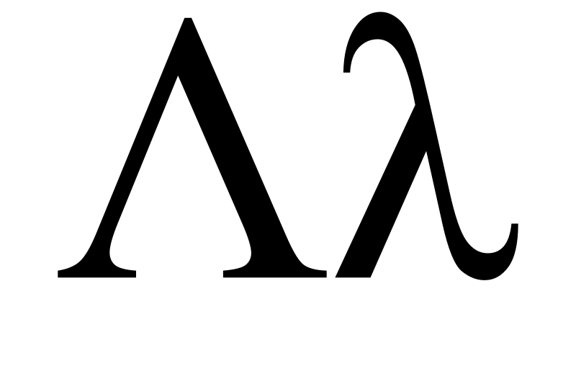
Lambda Expressions and LINQ
LINQ
var count = arr
.Where(e => e % 2 == 0)
.Count();
Live Exercises in Class (Lab)

Slide 28
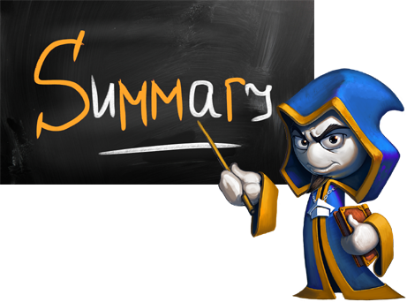
Summary
Lambda and LINQ dramatically simplify collection processing
Can be used for various data aggregation
Sorting
Filtering
Searching
Transforming Elements

Slide 29







Lambda and LINQ
https://softuni.bg/courses/programming-fundamentals

Slide 30
License
This course (slides, examples, demos, videos, homework, etc.) is licensed under the "Creative Commons Attribution-NonCommercial-ShareAlike 4.0 International" license
Attribution: this work may contain portions from
"Fundamentals of Computer Programming with C#" book by Svetlin Nakov & Co. under CC-BY-SA license
Icons from http://www.flaticon.com/ (credits: Freepik, Madebyoliver)

Slide 31





Trainings @ Software University
Software University Foundation – softuni.org
Software University – High-Quality Education, Profession and Job for Software Developers
softuni.bg
Software University @ Facebook
facebook.com/SoftwareUniversity
Software University Forums – forum.softuni.bg

